Slide 1
Neural Activation in the NAcc and Amygdala in Females Exposed to Low and High Levels of Early Life Stress
Joshua Ryu and Lauren Borchers
204B final project
06.06.2019
Notes:
Lauren

Slide 2
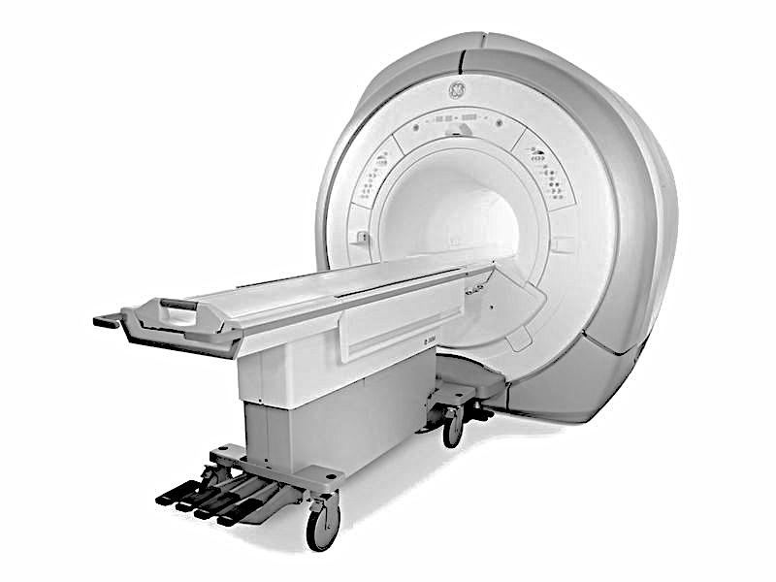
ELS STUDY DESIGN
Adolescents came to the lab between the ages of 9-12 years old
Behavior
demographic characteristics
early life stress
fMRI
functional MRI
3.0 Tesla FE MRI scanner
Notes:
Josh

Slide 3
TRAUMATIC EVENTS SCREENING INVENTORY FOR CHILDREN
Example
Have you ever been in a really bad accident, like a car accident, a fall or a fire? Did you feel as scared as you'd ever been, like this was one of the scariest things that EVER happened to you? Did you feel confused or mixed up (or helpless)? Did you feel sick or disgusted (or horrified)?
Response: Dichotomous item ("Yes" or "No")
Panel rated the objective severity using the UCLA Interview coding system
0 = non-event; 4 = severe event
Sum severity for each stressful event
Ippen et al., 2002; Ribbe 1996
Notes:
Lauren

Slide 4
KIDMID
Parameters
slice thickness = 3
number of slices = 43
Phases = 250
time of the scan = 8:20
FOV = 224 x 224
TR = 2
voxel size=3.2 x 3.2 x 3.0 mm
Each block was 6 seconds
Cue types
250 ms
Fixation
2-2.5 seconds
Target
250-350 ms
+ 1 point
Feedback
1.65 seconds
- 5 points
Knutson et al., 2000
Notes:
Lauren

Slide 5

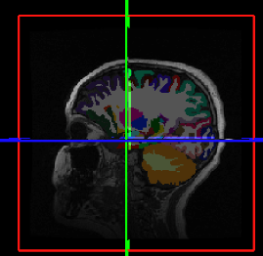
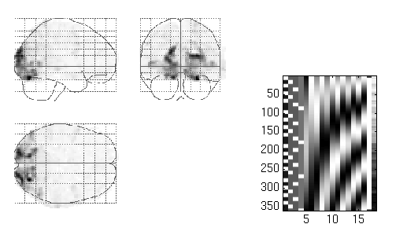

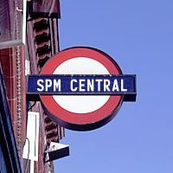
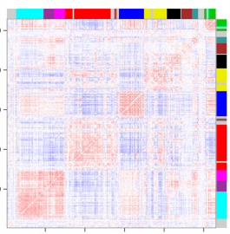

ANALYSIS PIPELINE
Functional images
Anatomical Image
Segmentation
Realignment
Coregistration
Extract ROIs
Timecourses
General Linear
Model
SPM
Functional
connectivity
Between subject
analyses
Notes:
Josh

Slide 6
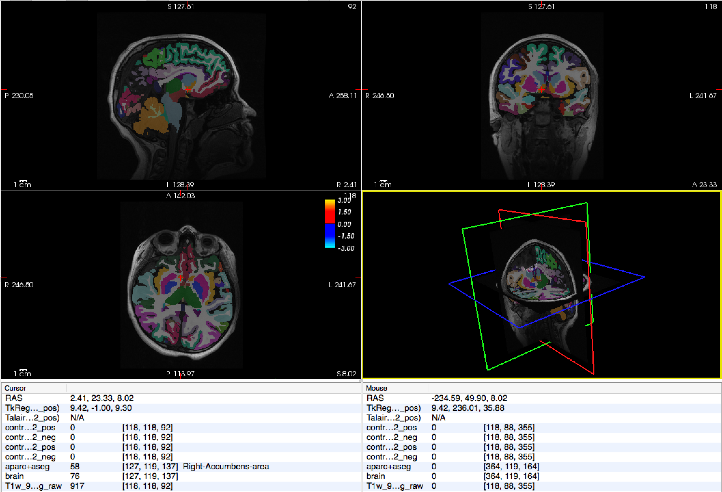
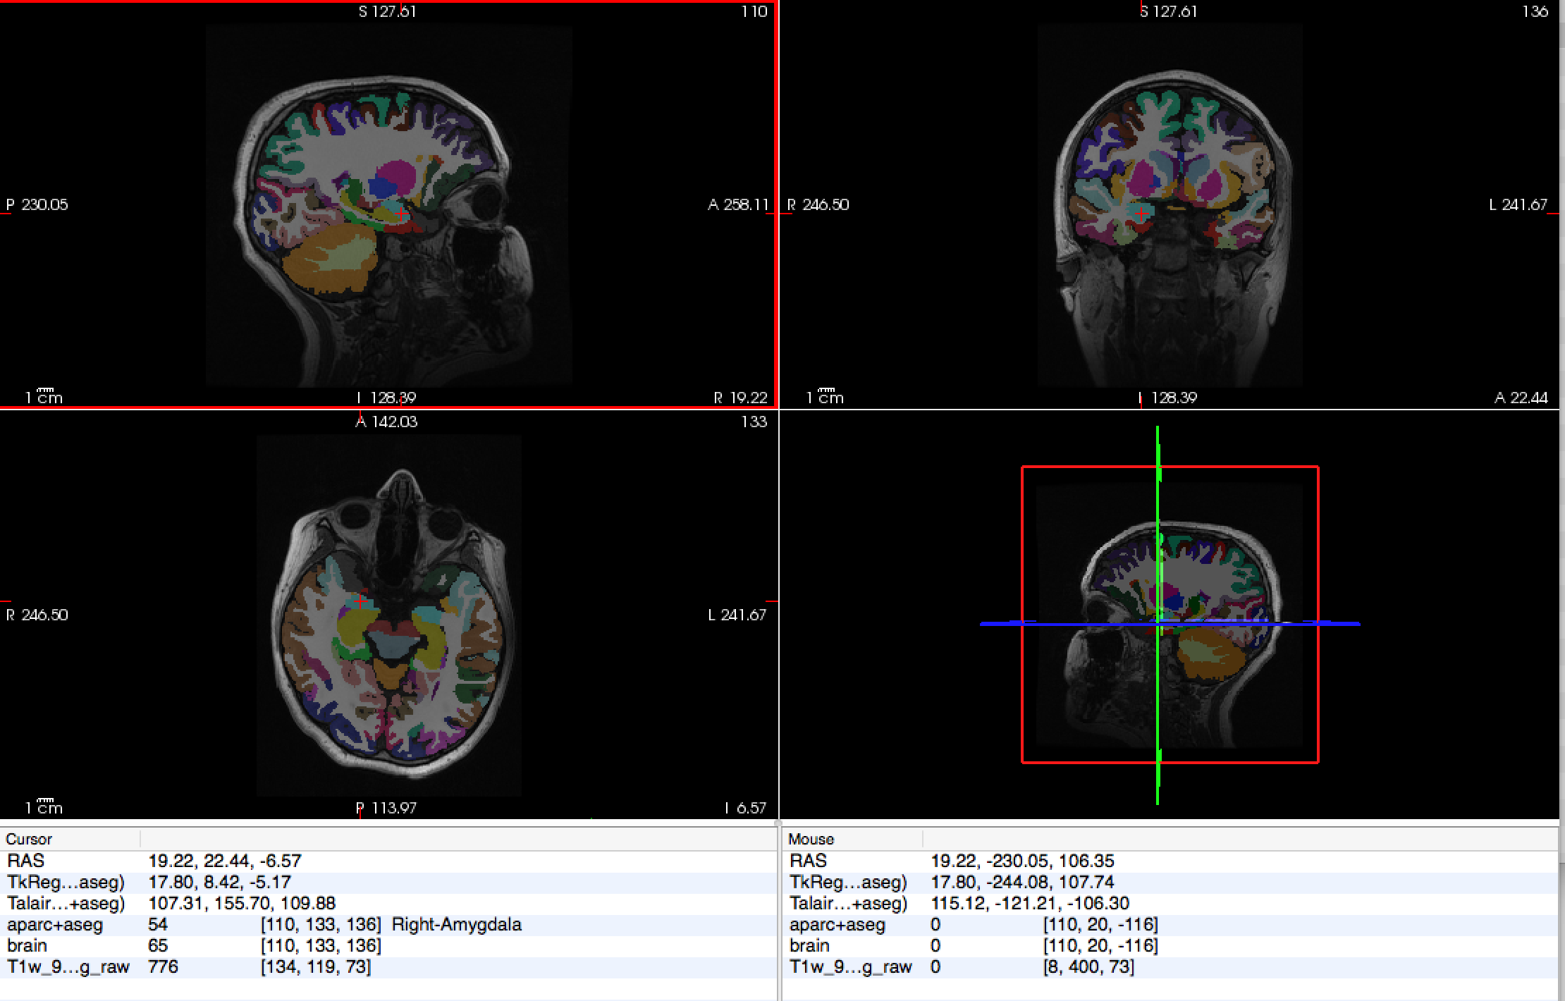
FREESURFER
NAcc: length 10.5, width = 14.5, height = 7
(Neto et al., 2008)
Average size of amygdala = 1.24 cm³ (SD=0.14) (Brabec et al., 2010)
~740 mm³
~1660 mm³
²¹ Dennis et al., 2019
E.g. Dale et al., 1999; Dale and Sereno, 1993; Fischl and Dale, 2000; http://surfer.nmr.mgh.harvard.edu/
Notes:
Lauren (aparc and aseg)
Lots of Atlases (manually labeled ROIs; from that they made a probabilistic map they use that to segment cortical regions, Fishel et al. generated a probabilistic map to segment subcortical regions

Slide 7
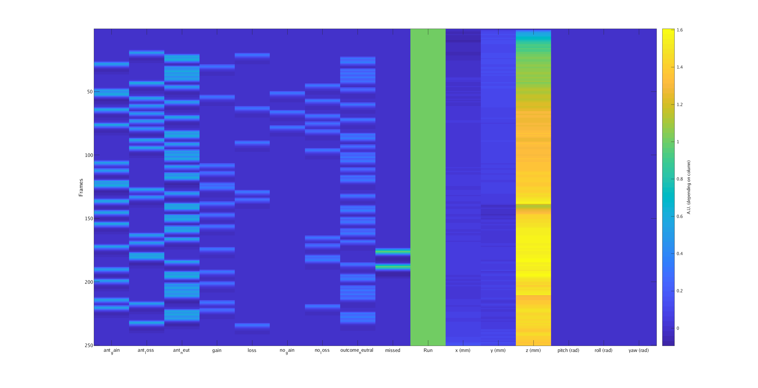
GENERAL LINEAR MODEL
ant gain
ant loss
ant_neu
gain
loss
no gain
no loss
out neu
miss
run
x mm
y mm
z mm
pitch
roll
yaw
Notes:
Josh

Slide 8
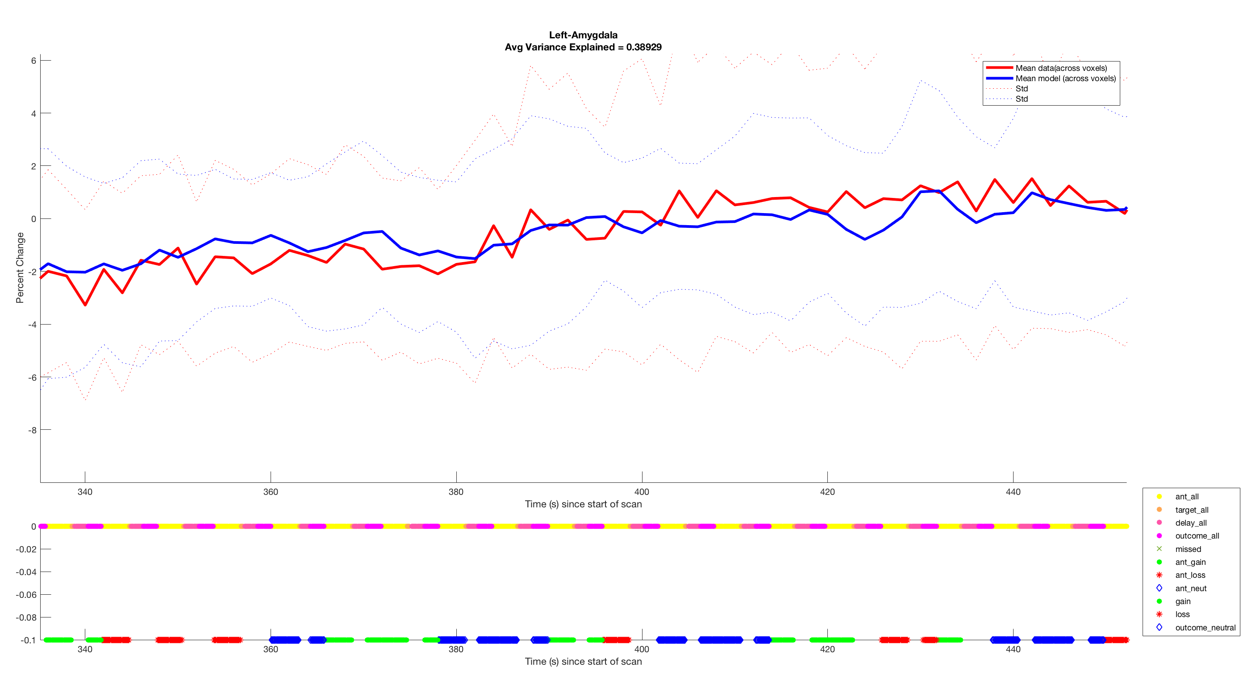
TIMECOURSE
Notes:
Lauren

Slide 9
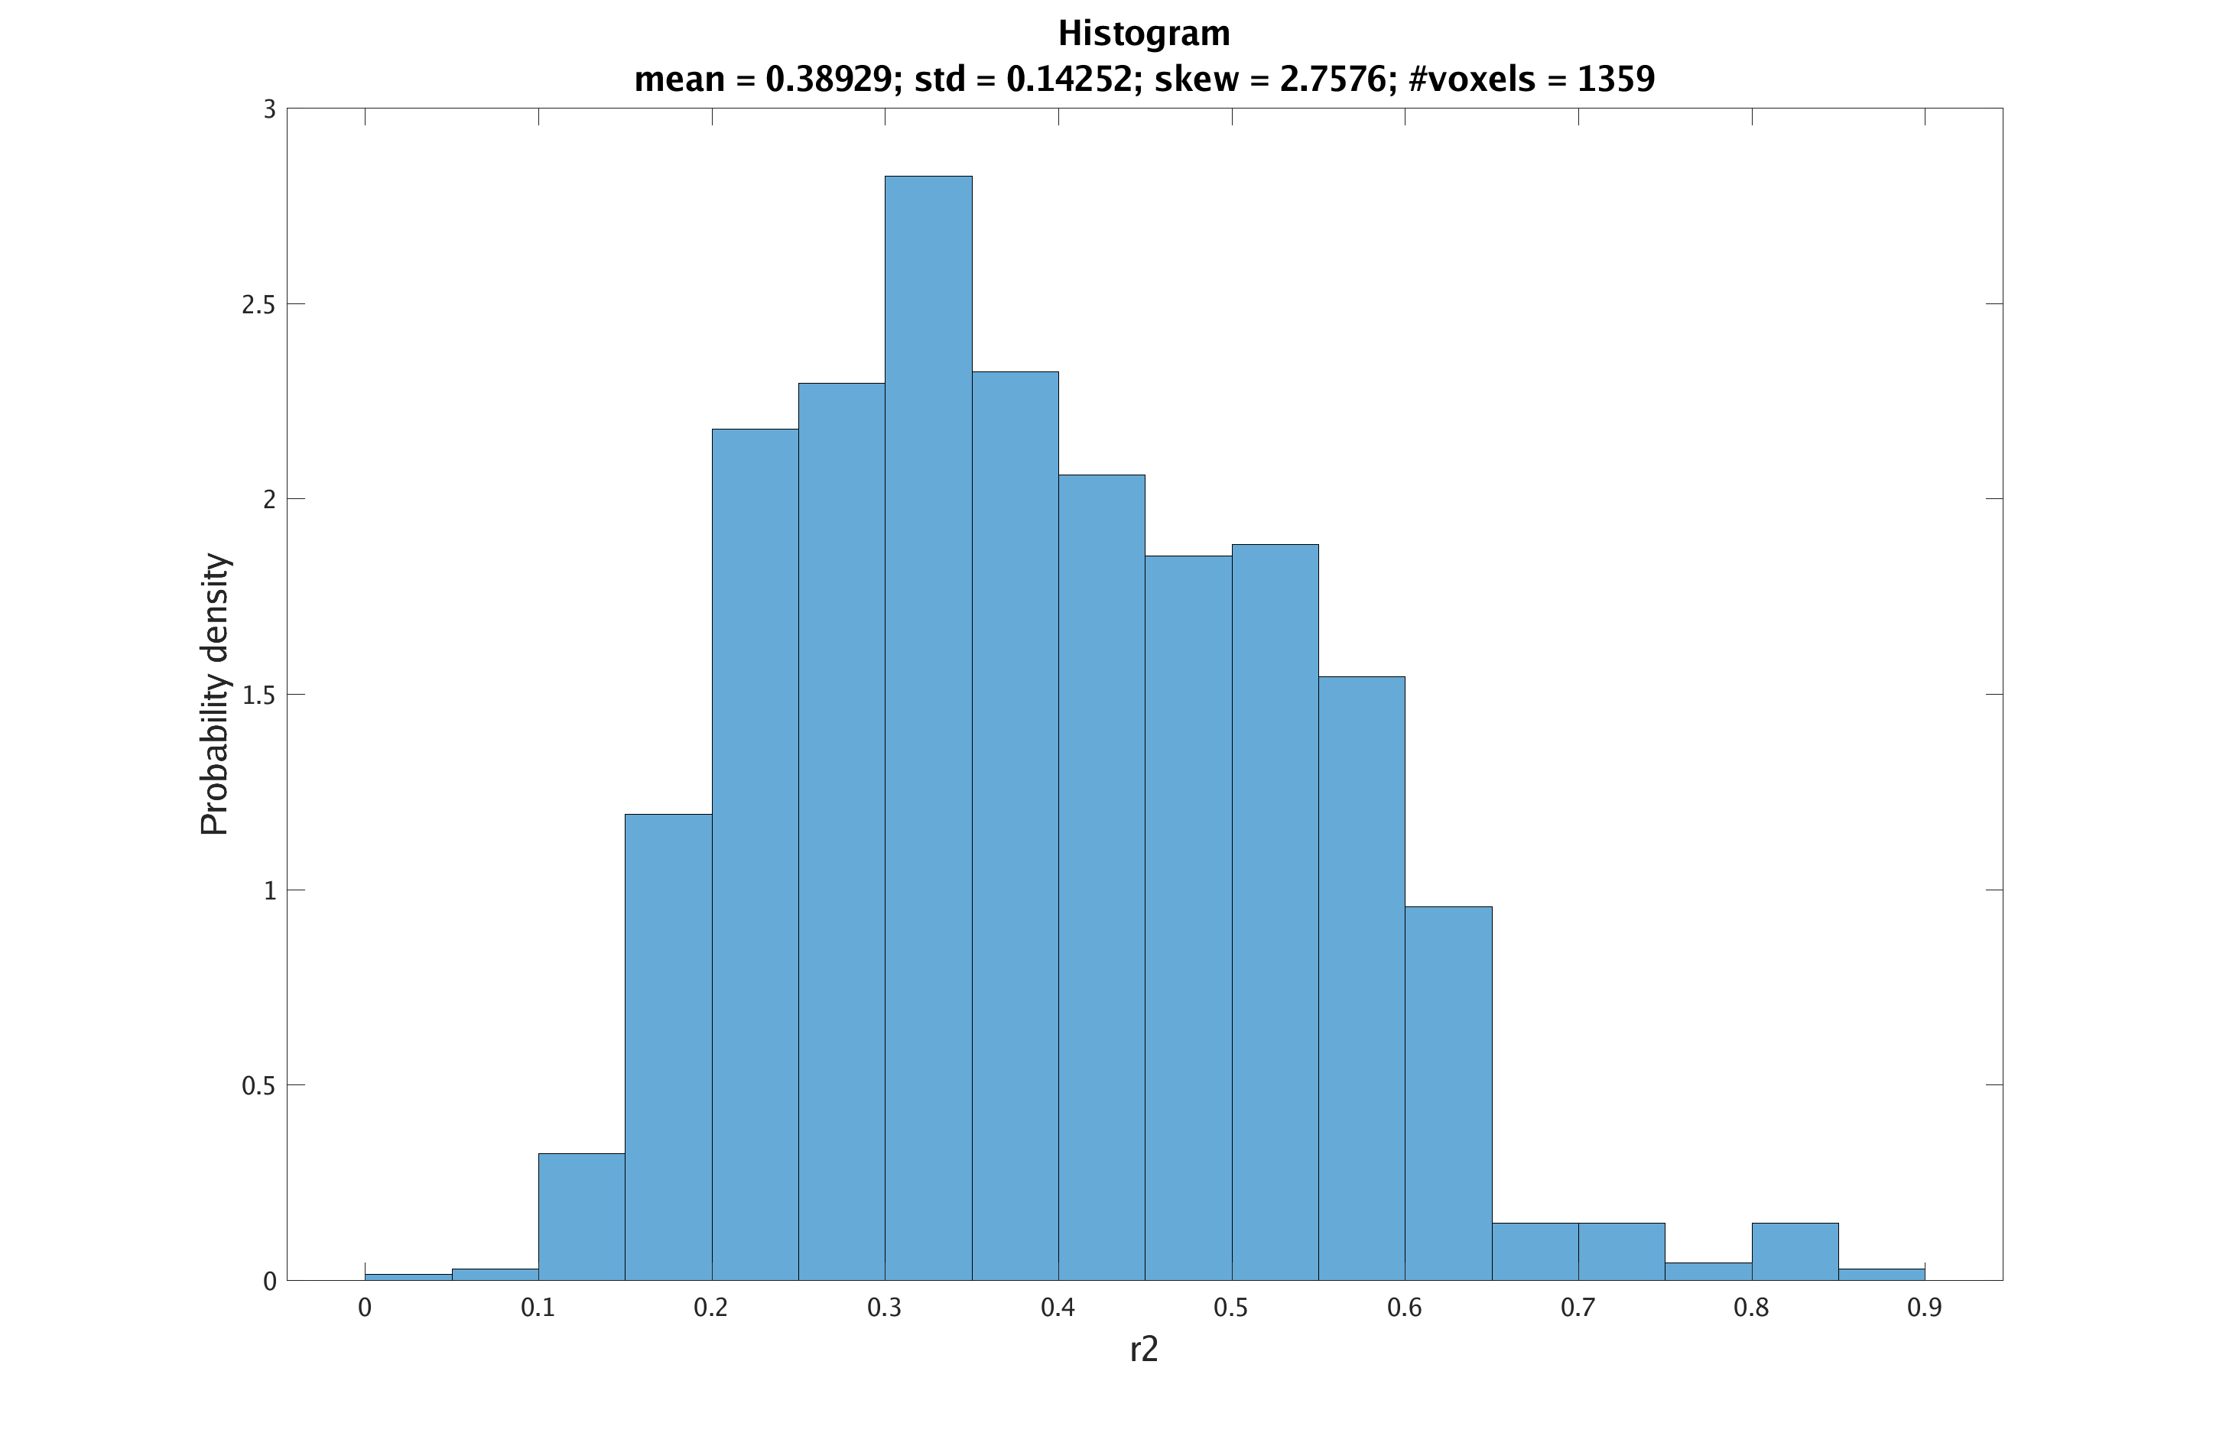
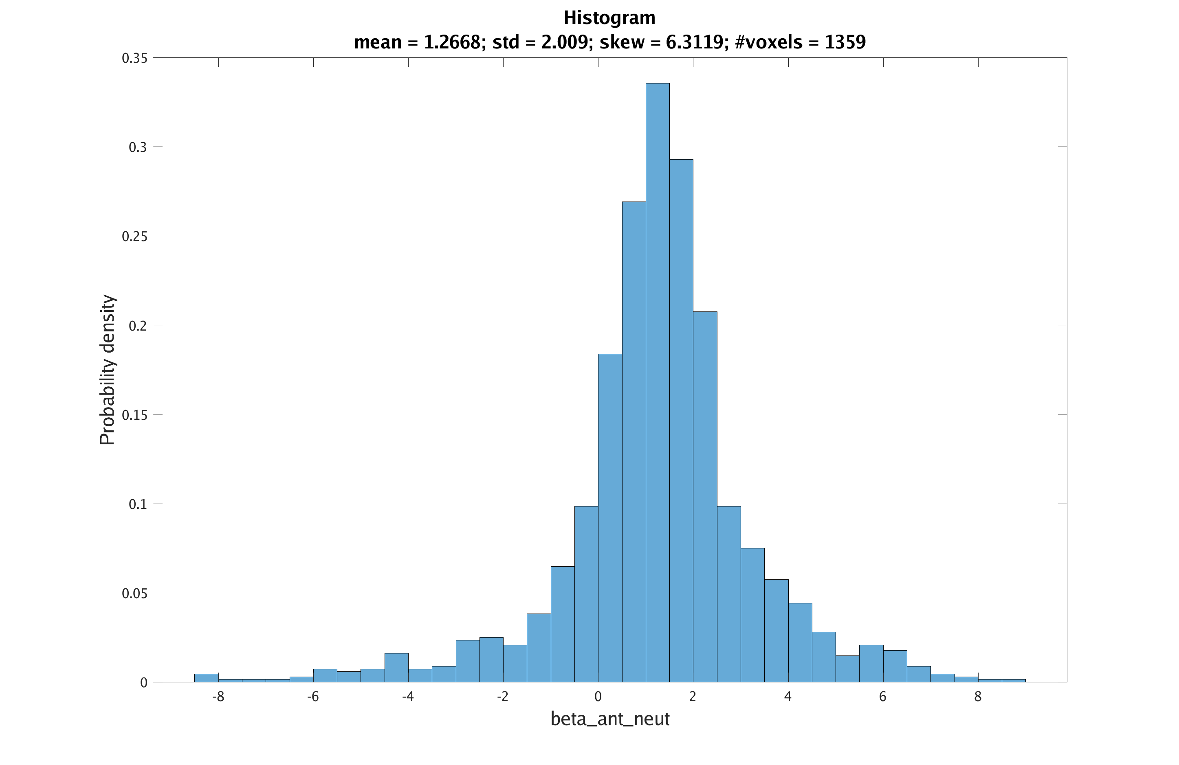
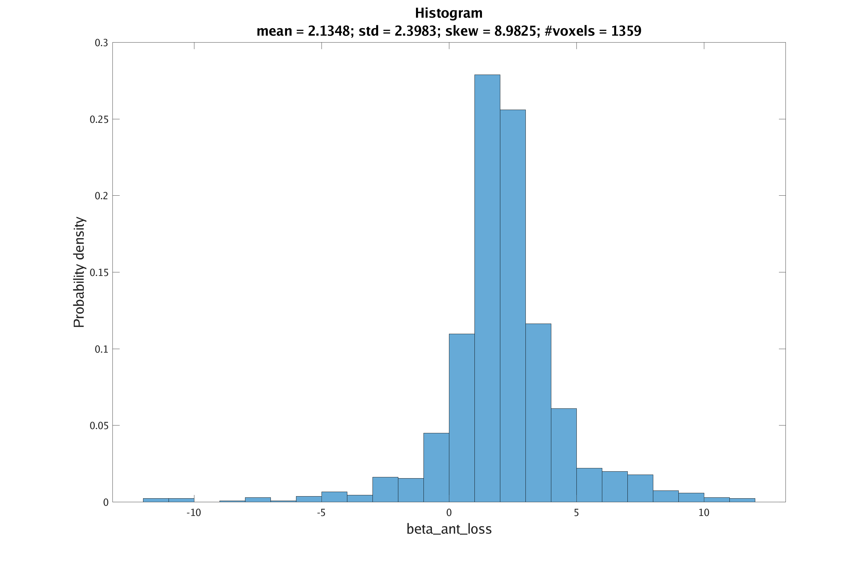
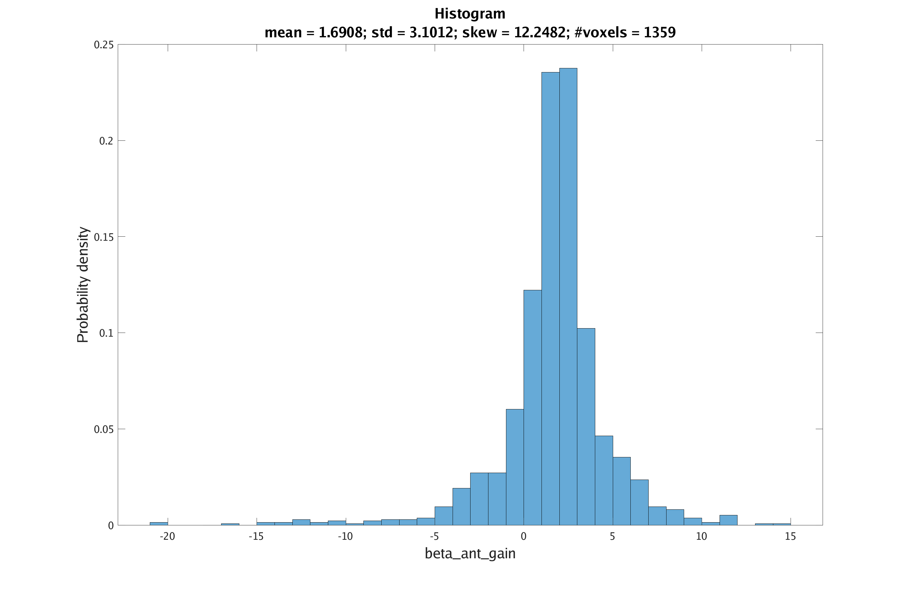
HISTOGRAMS OF BETA WEIGHTS
r²
ant neu (β)
ant loss (β)
ant gain (β)
Notes:
Josh

Slide 10
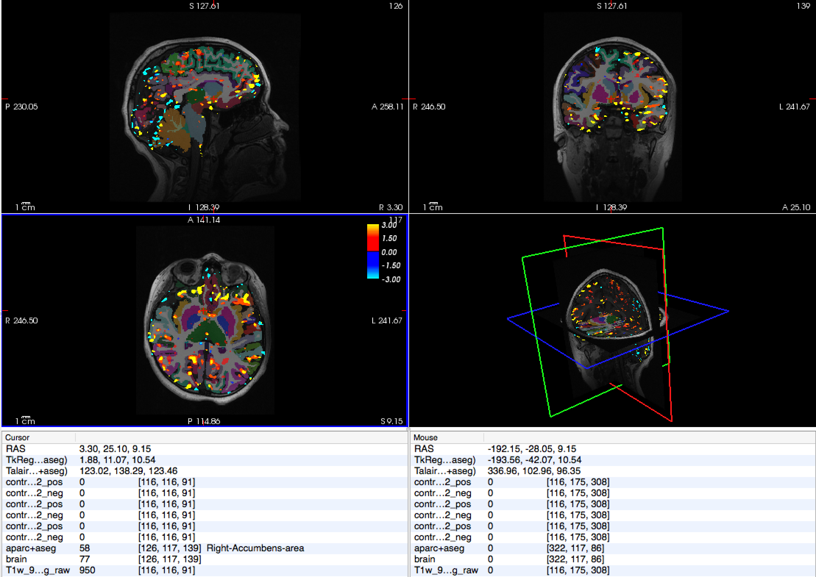
ANTICIPATION OF GAIN contrast to neutral –high vs. low ELS
116-T1
Notes:
Lauren

Slide 11
ANTICIPATION OF GAIN contrast to neutral –high vs. low ELS
116-T1
Notes:
Lauren

Slide 12
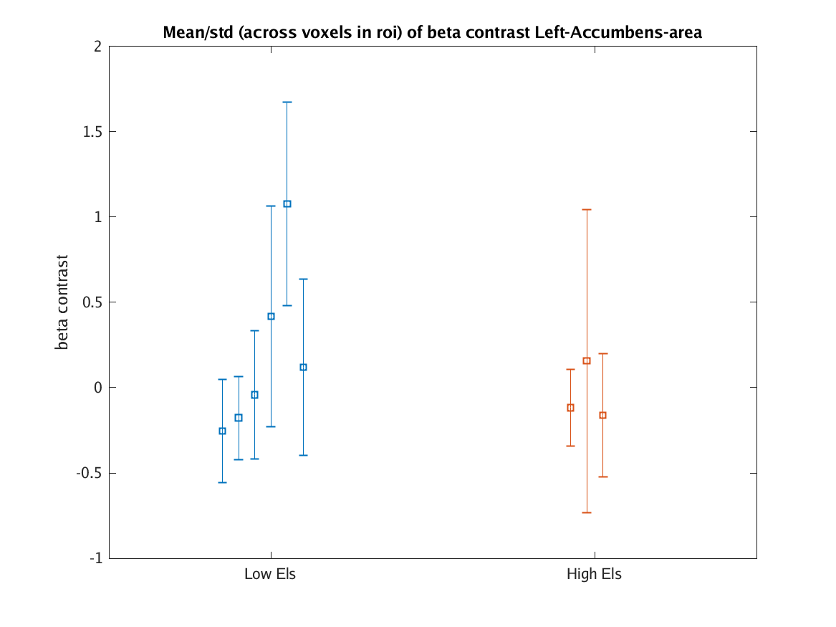
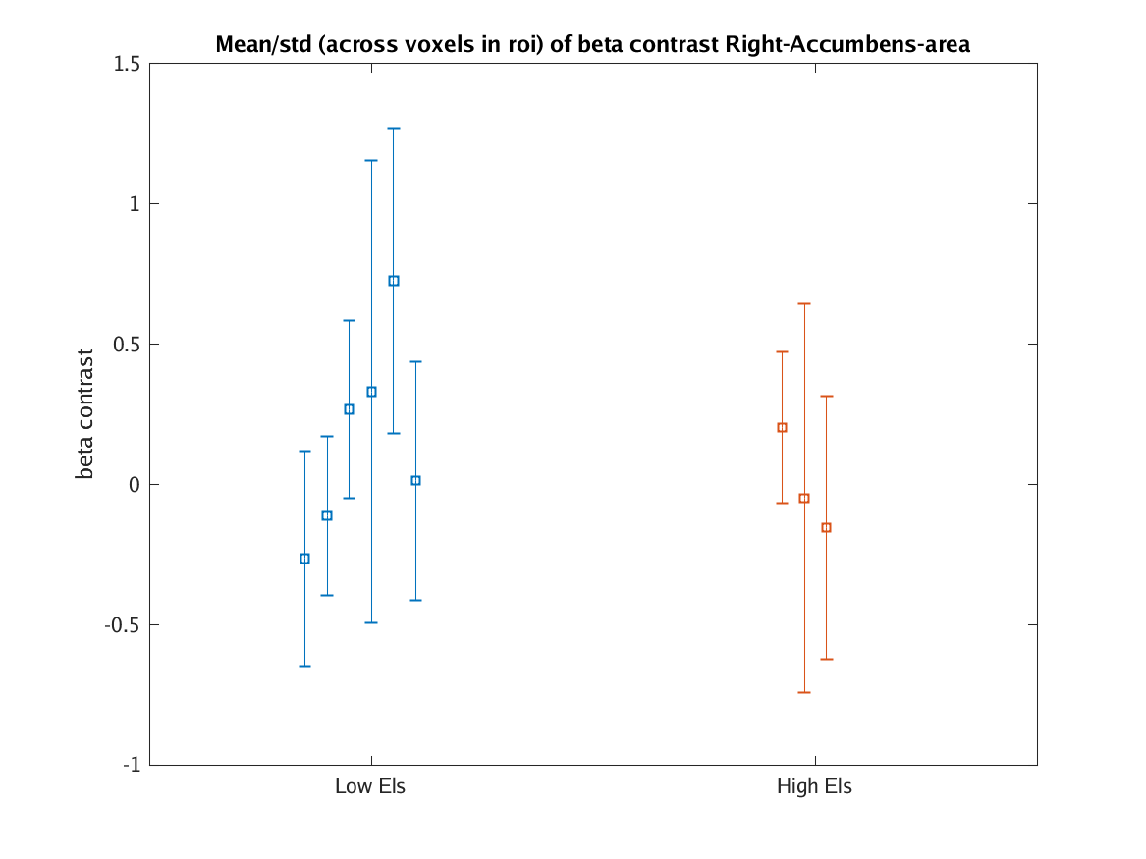
ANTICIPATION OF GAIN contrast to neutral –high vs. low ELS
Notes:
Lauren

Slide 13
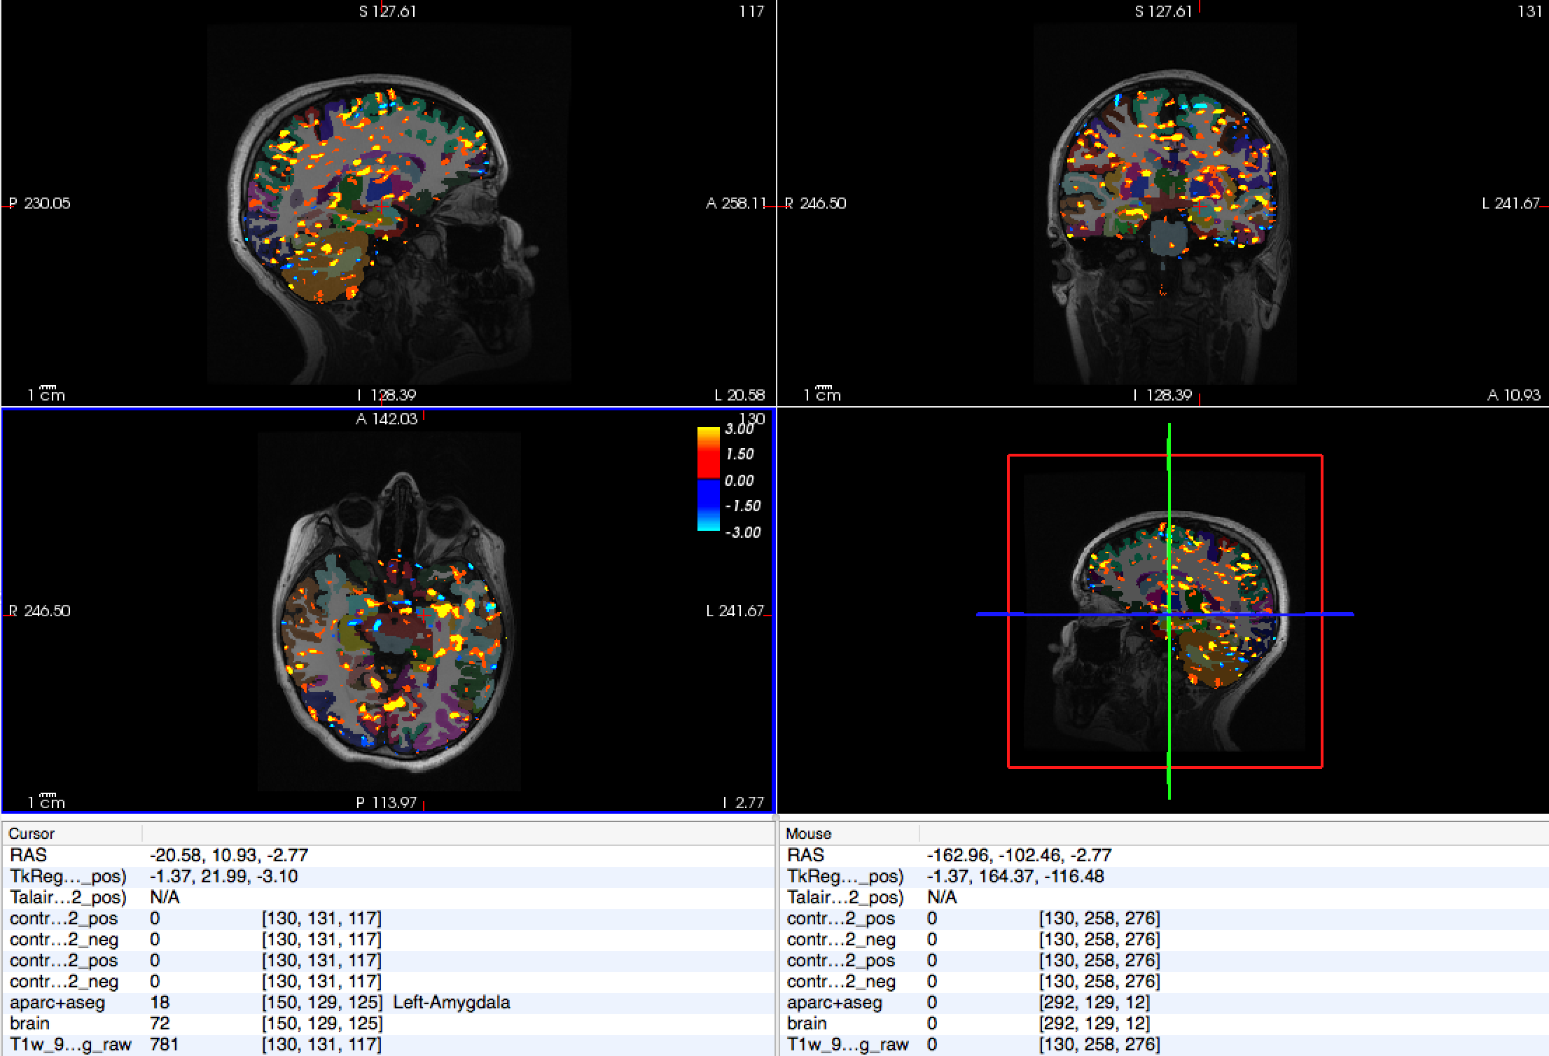
ANTICIPATION OF LOSS contrast to neutral –high vs. low ELS
116-T1
Notes:
Josh

Slide 14
ANTICIPATION OF LOSS contrast to neutral –high vs. low ELS
116-T1
Notes:
Josh

Slide 15
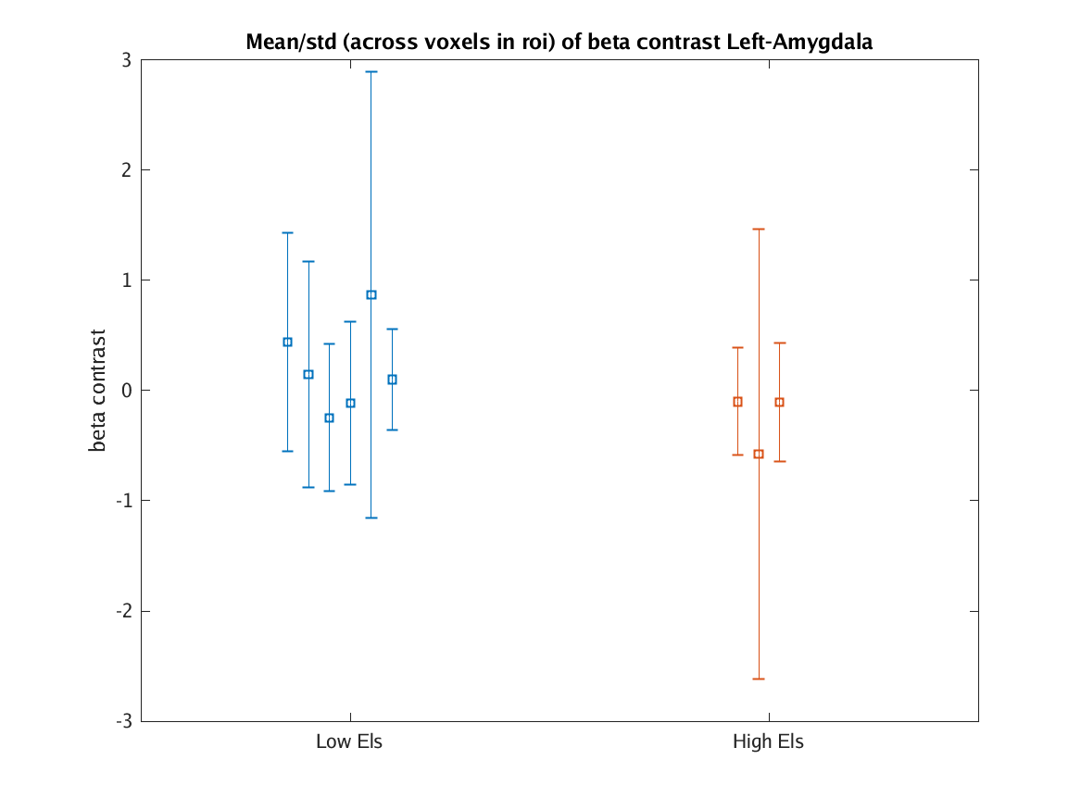
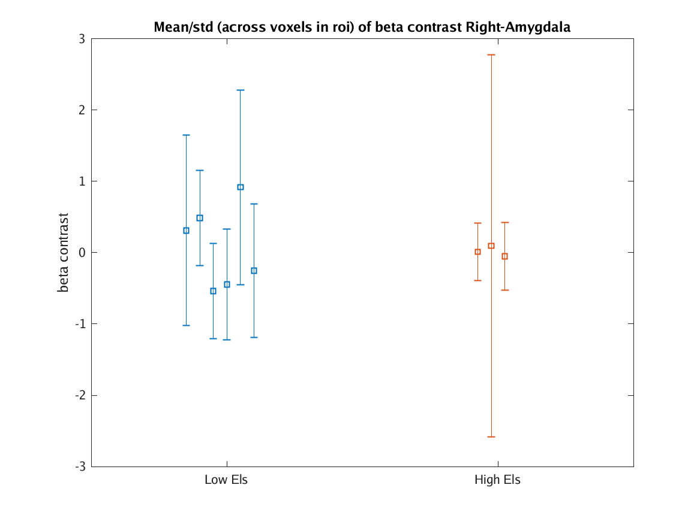
ANTICIPATION OF LOSS contrast to neutral –high vs. low ELS
Notes:
Josh

Slide 16
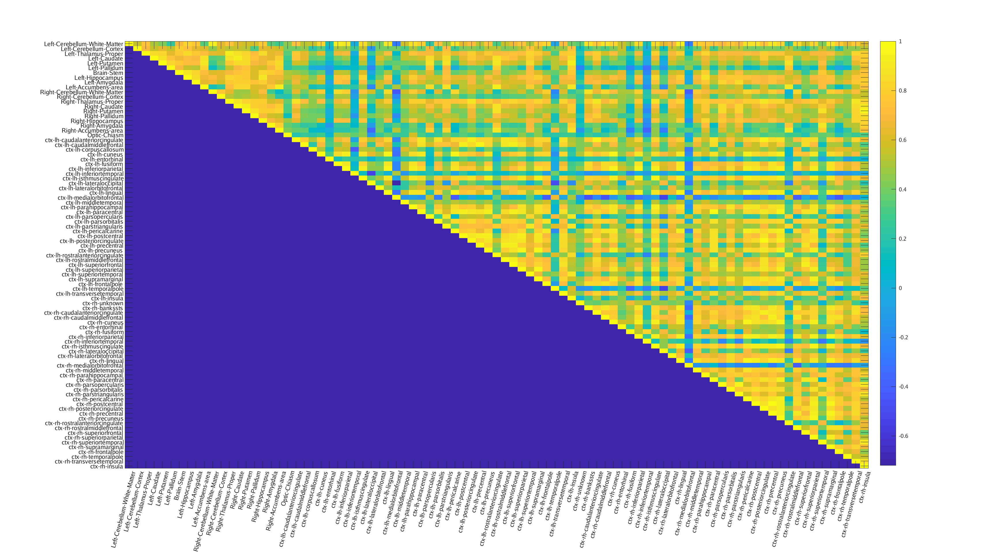
FUNCTIONAL CONNECTIVITY
1.00
-0.60
Notes:
Lauren

Slide 17
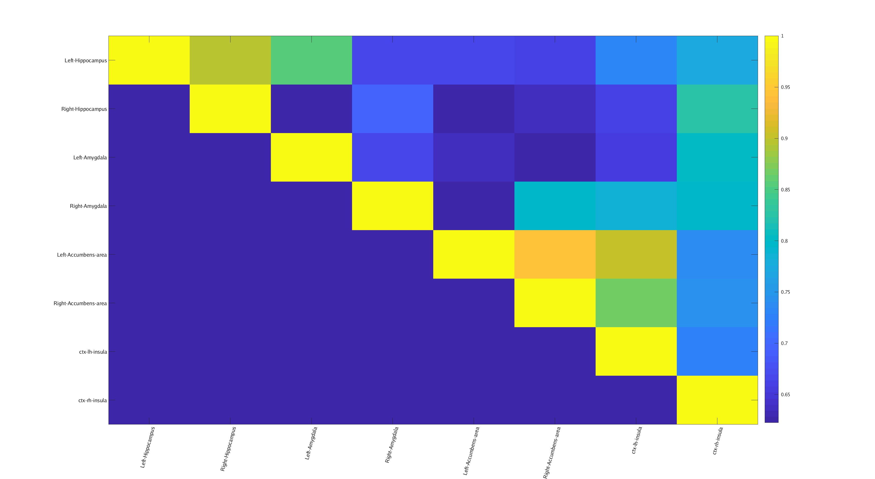
FUNCTIONAL CONNECTIVITY
1.00
0.65
Notes:
Lauren

Slide 18
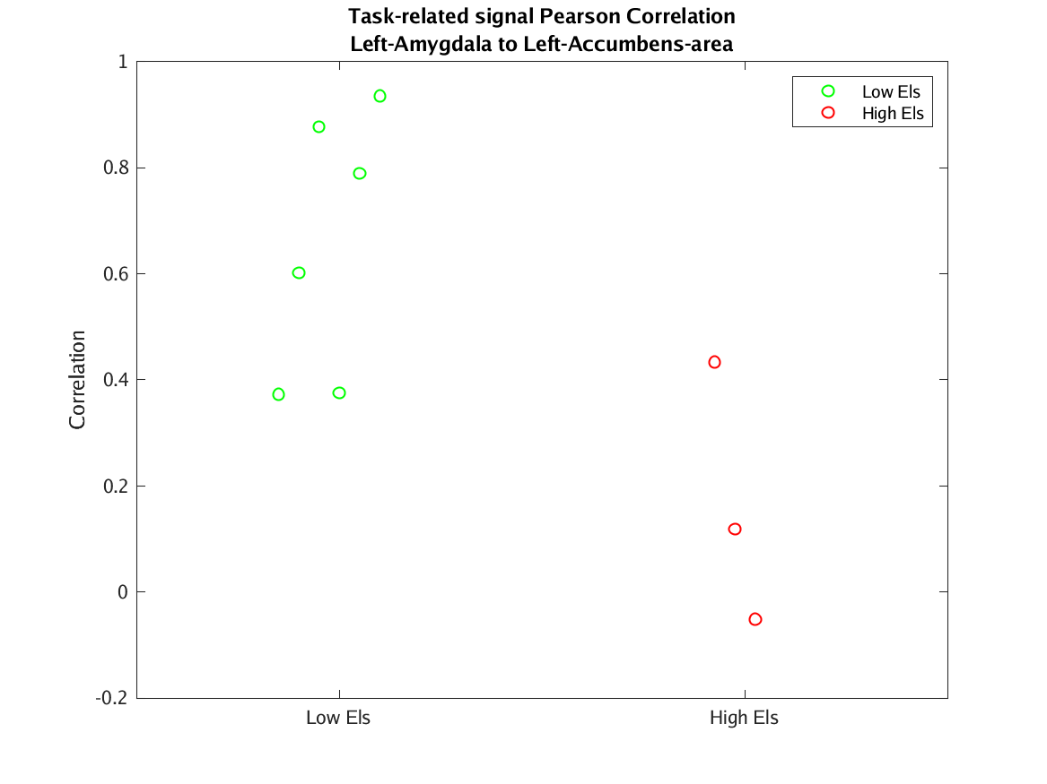
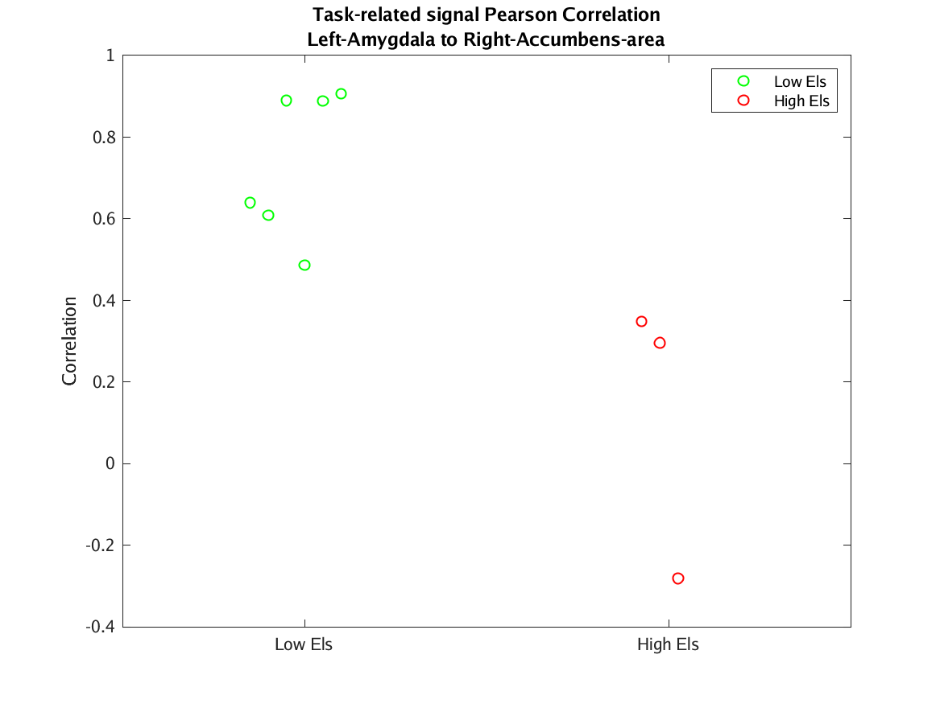
FUNCTIONAL CONNECTIVITY
Notes:
Lauren

Slide 19
SUMMARY
No significant changes in hemodynamic response in NAcc during anticipation of reward
No significant changes in hemodynamic response in amygdala during anticipation of loss
Participants exposed to low ELS showed more coactivation between ROIs than participants exposed to high ELS
Notes:
Josh

Slide 20
LIMITATIONS
Small sample size!
Segmentation can be improved!
Improve tracking parameters for FreeSurfer;
Manual segmentation
Use different parcellations
Functionally defined ROIs (ICA, PCA)
GLM considerations
Ill-conditioned regressions => ridged regression
Modeling temporal autocorrelations
Notes:
Josh

Slide 21
QUESTIONS

Slide 22
T1-weighted SPGR
T1-weighted image in the sagittal view (SPGR)
slice thickness=0.9
frequency Rx direction=S/I sagittal
length of scan=5:15
FOV=230x230
TR= 0.00624
voxel size =0.90 x 0.90 x 0.90 mm

Slide 23
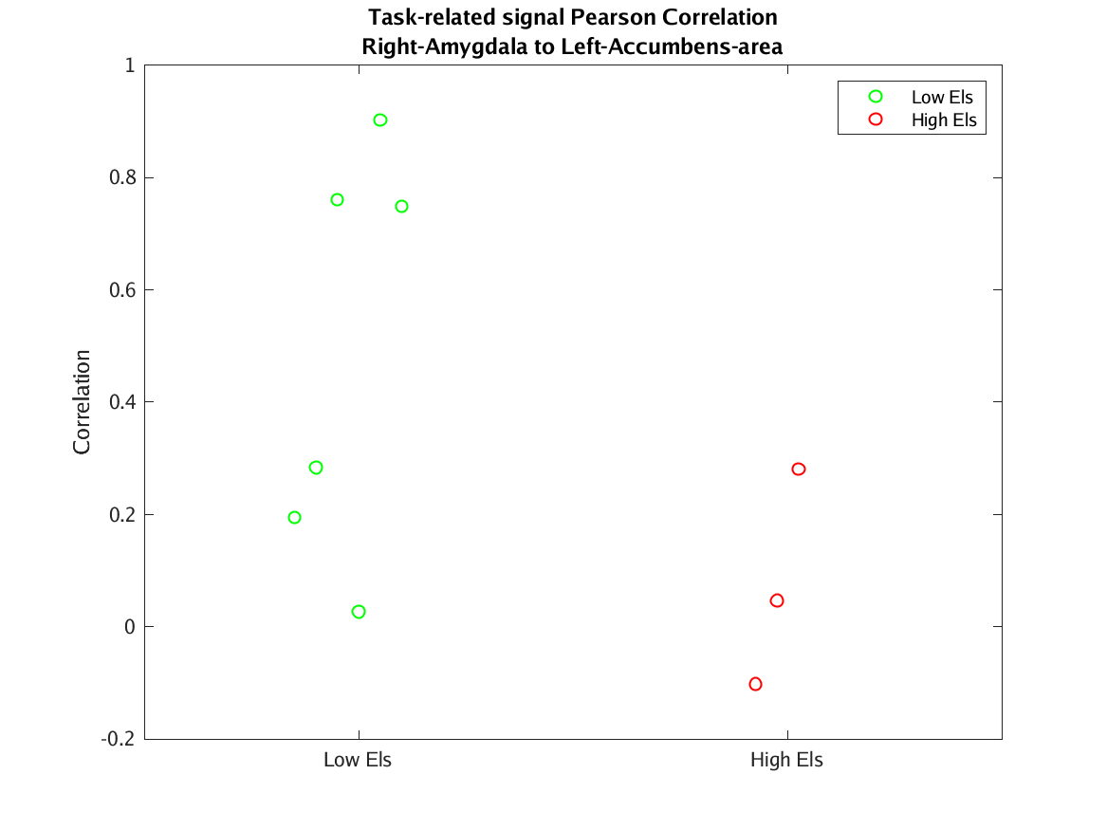
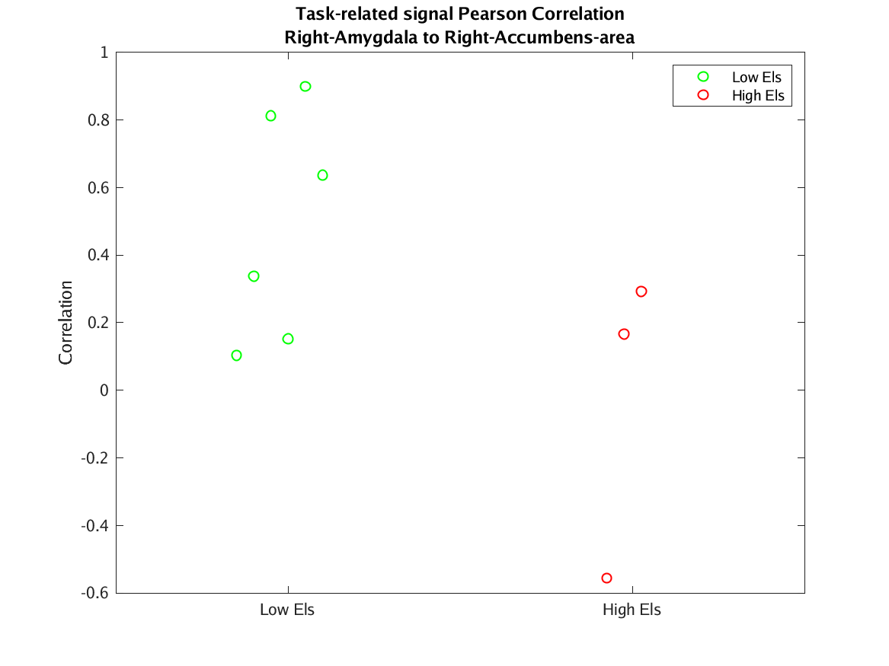
FUNCTIONAL CONNECTIVITY

